Slide 1

Cloud watch concepts

Slide 2

Cloud watch concepts
Monitor your AWS Resources and take actions

Slide 3
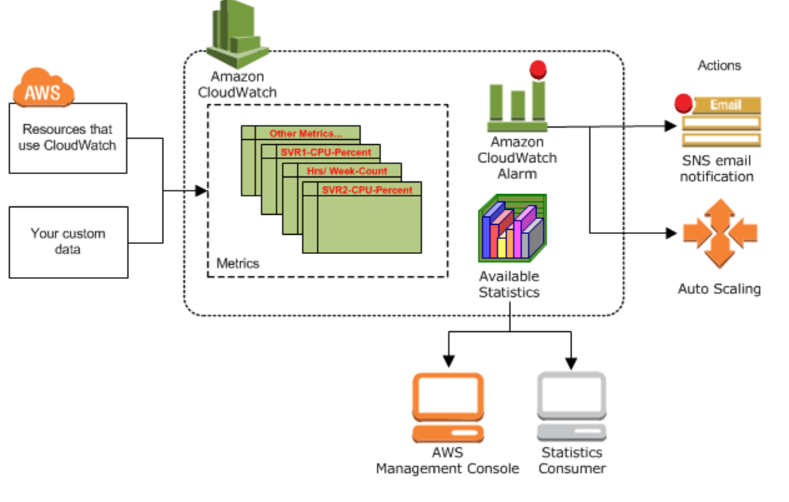
Cloud watch concepts

Slide 4
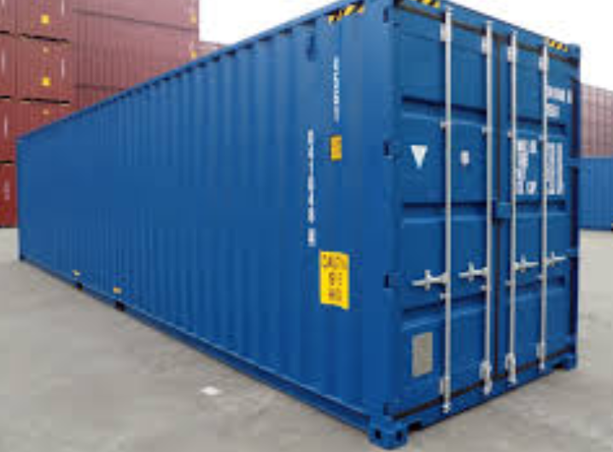

Cloud watch concepts
Namespaces
Containers for storage of metrics
AWS/service naming convention
Metrics
Fundamental information that is being captured
EC2 cpu usage
EC2 bytes transferred in and out
Data is stored till for 15 months.

Slide 5
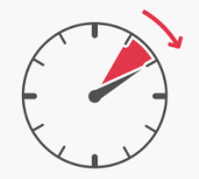

Cloud watch concepts
Time stamp
Information about the metric time
Preferred to be stored in UTC
Metric retention
Data being withheld for time based on the time duration
Less than 60 sec for 3 hrs
1 minute for 15 days
5 mins for 63 days
1 hr for 455 days

Slide 6

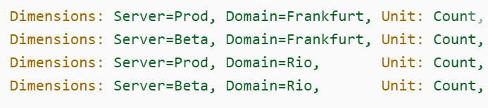
Cloud watch concepts
Dimension
Additional details for the metric
Upto 10 dimension for metric
Eg. InstanceID for EC2 metrics
Dimension Combination
Combinations as a separate metric.
Metric uses multiple combination.
Cannot take reports separately

Slide 7
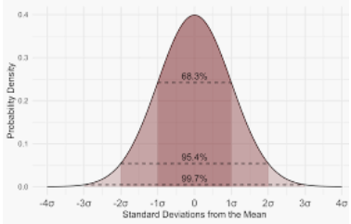
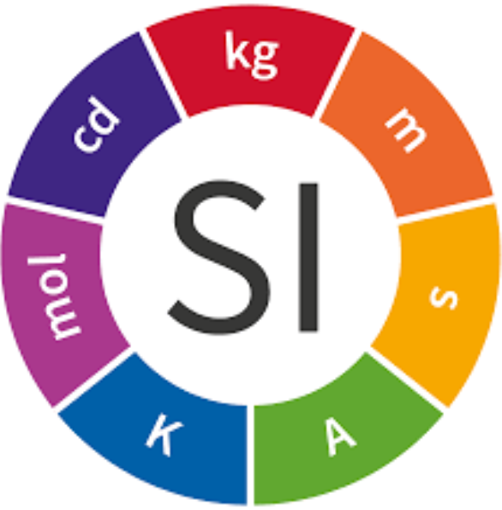
Cloud watch concepts
Statistics and Aggregation
Get stats on data…
Min
Max
Sum
Average
takeSample
Units
Bytes
Seconds
Count
Percent
Default None

Slide 8
Cloud watch concepts
Periods
Mentioned in seconds…
1
5
10
30
60
360

Slide 9
Cloud watch concepts
Alarms
It specifies the automatic triggering
Of:
Triggering for sustained state presence
Size of alarm greater than metric period

Slide 10
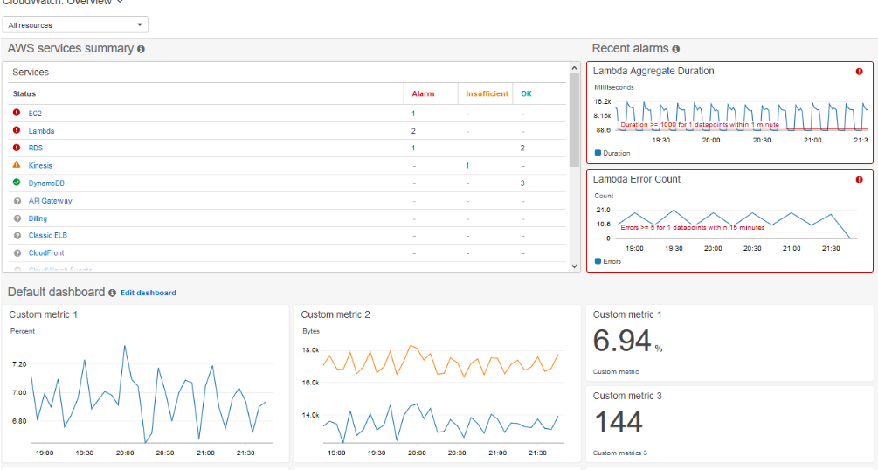
Cloud watch concepts

